Slide 1

Notes:
Challenger opener: the deck leads with a commercial teaching insight, not the product. The one orange figure is the night that pays for the week.

Slide 2
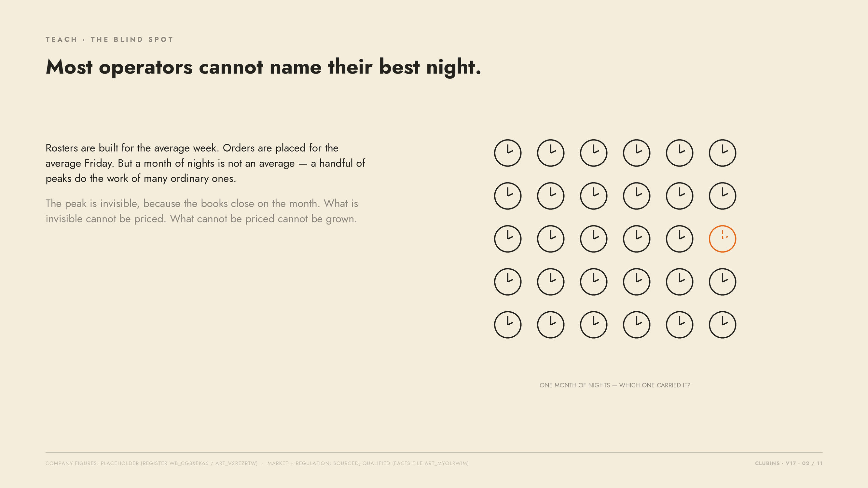
Notes:
Teach: averages hide peaks. The month grid is illustrative, not data.

Slide 3
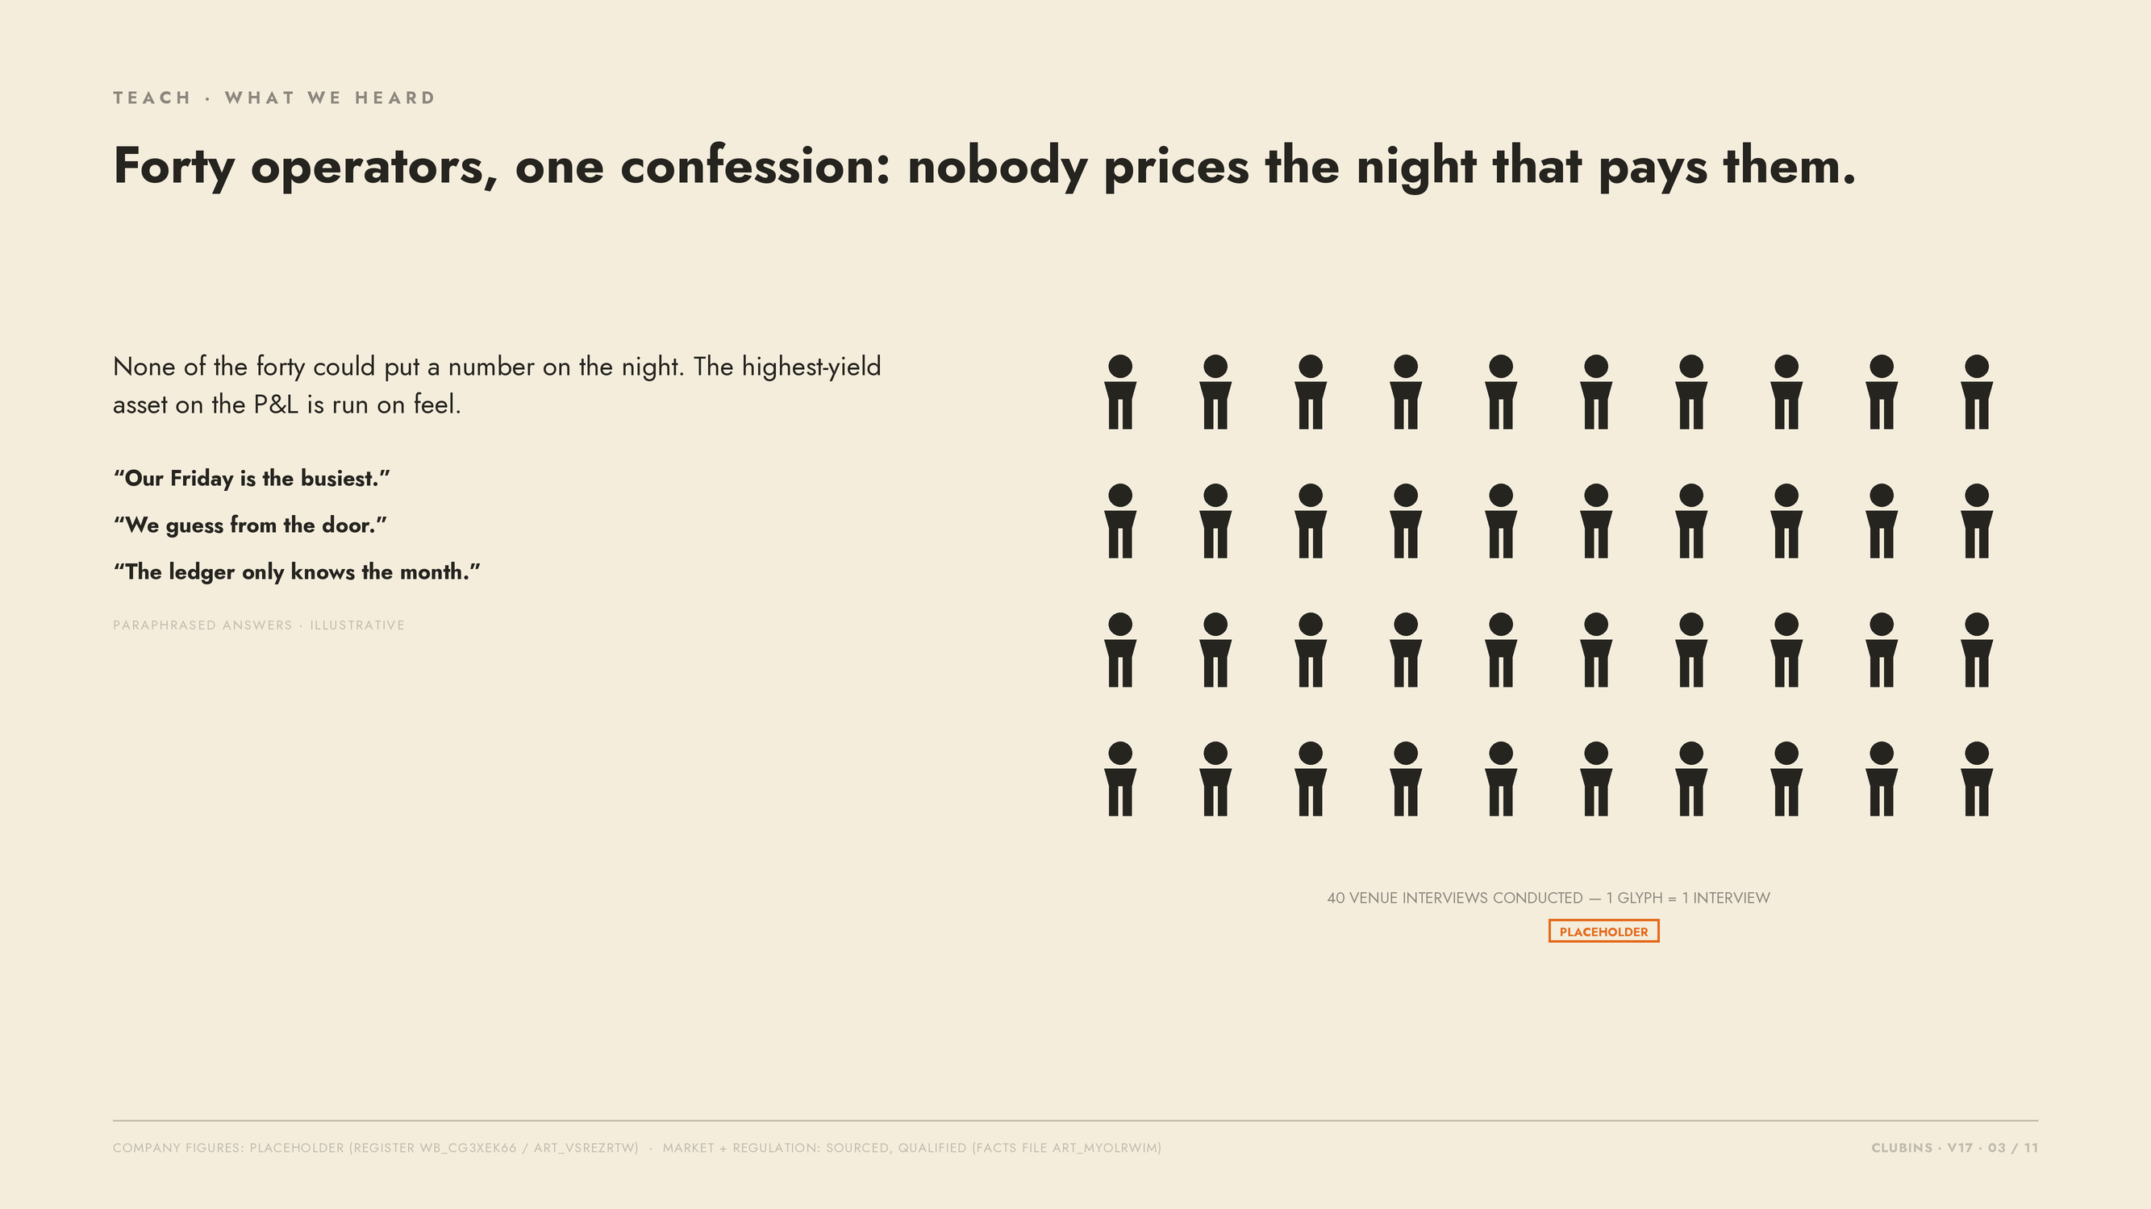
Notes:
Company figure 40 = PLACEHOLDER register value. Quotes are illustrative paraphrases.

Slide 4
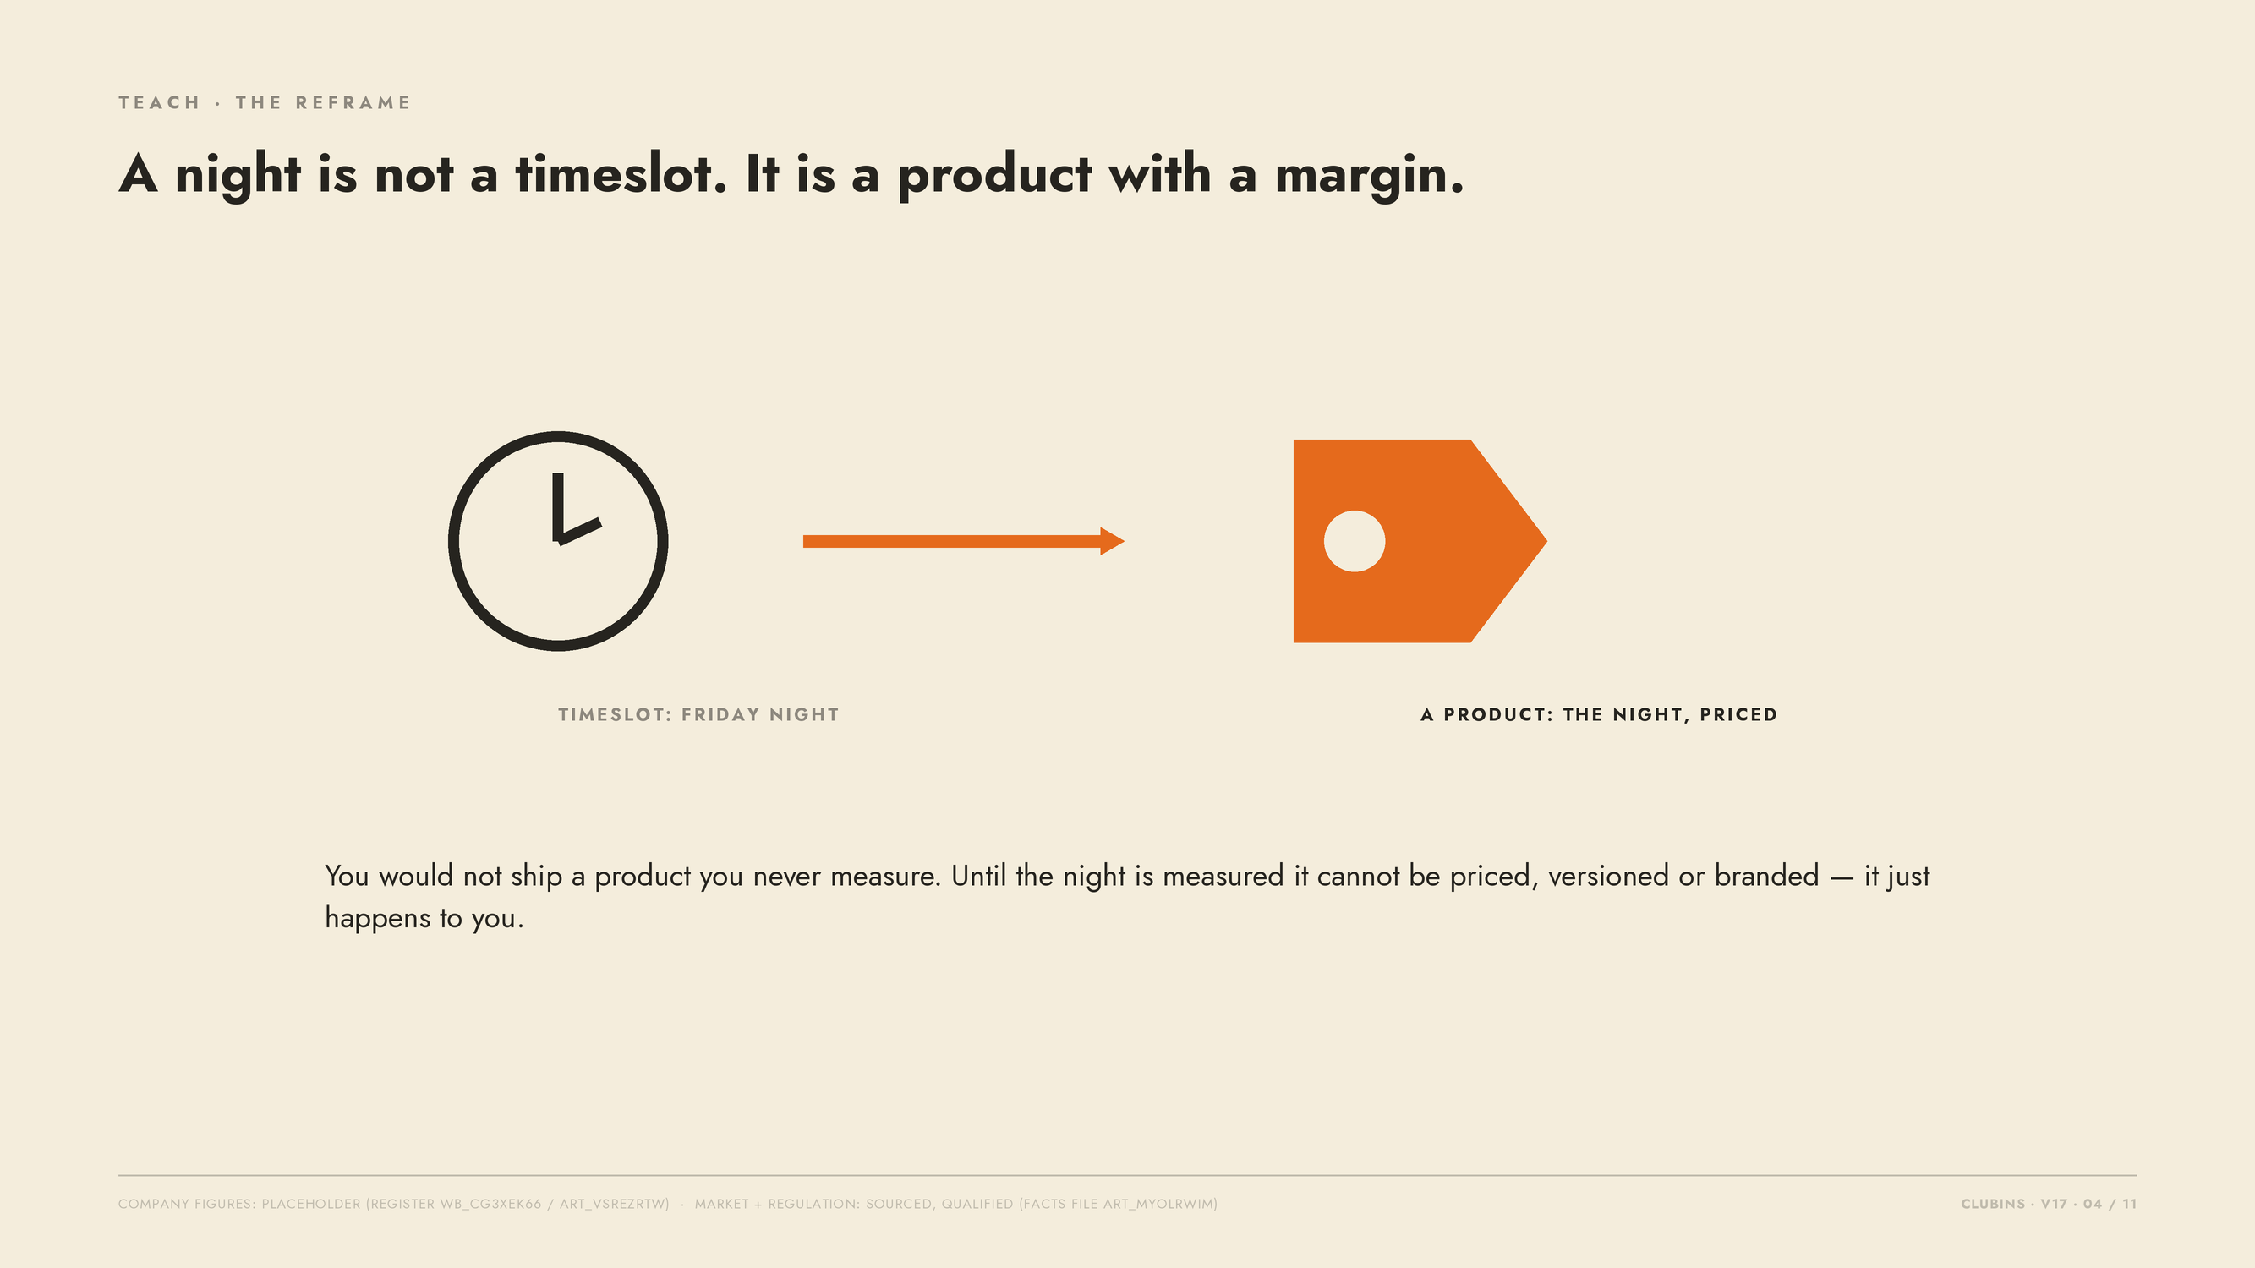
Notes:
The reframe: night as product. No numbers on this slide.

Slide 5
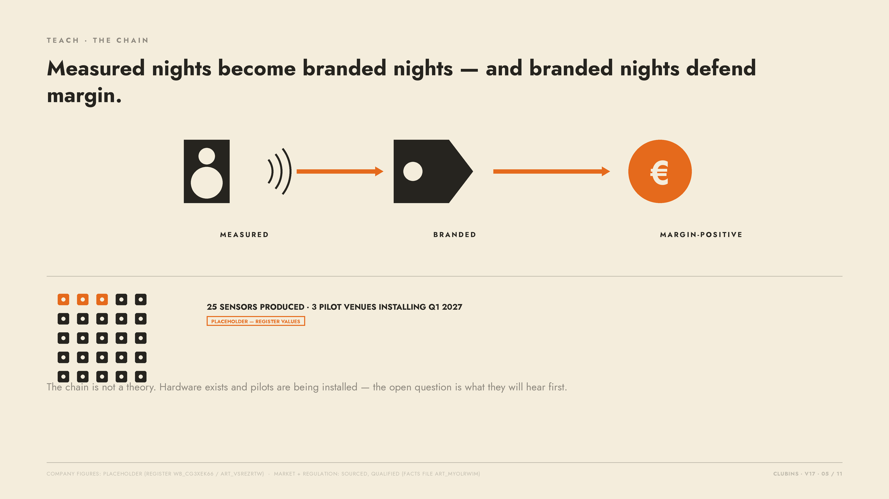
Notes:
Chain slide. 25 sensors / 3 pilots = PLACEHOLDER register values.

Slide 6
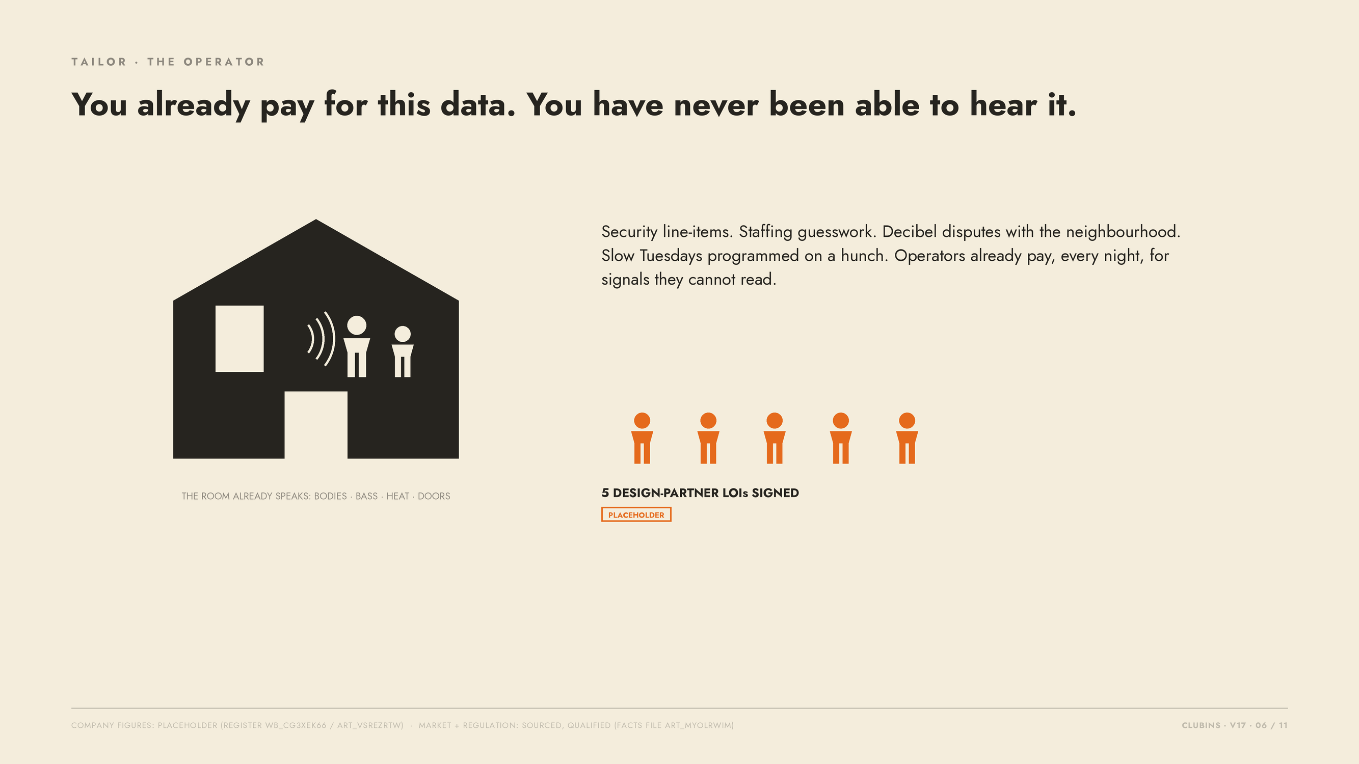
Notes:
Tailor to the operator. 5 LOIs = PLACEHOLDER register value.

Slide 7
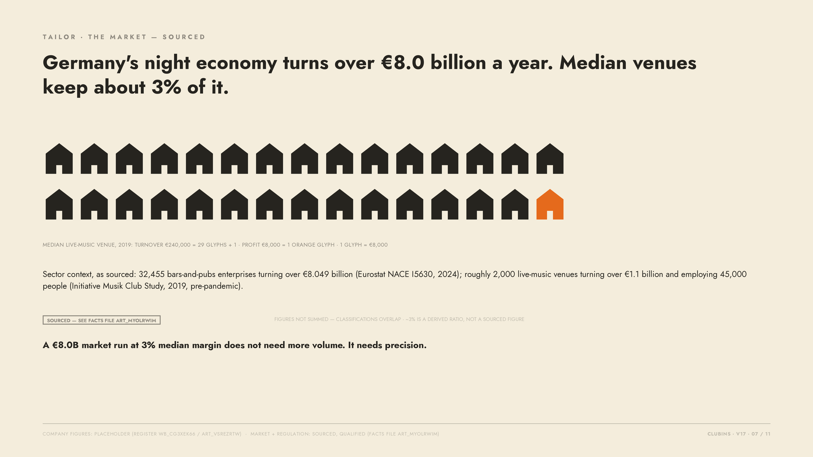
Notes:
Sourced market slide: Eurostat NACE I5630 2024; Initiative Musik Club Study 2019 via miz.org. Figures not summed. 3% is a derived ratio, not a sourced figure.

Slide 8
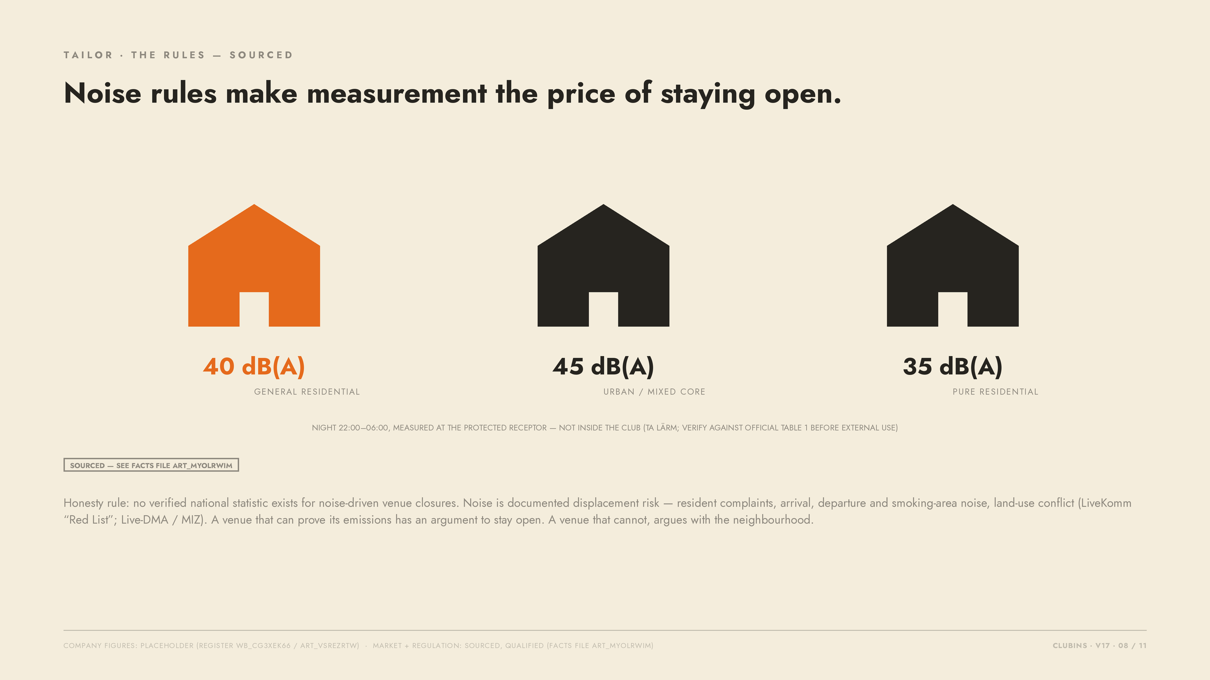
Notes:
Sourced regulation slide: TA Laerm receptor limits; honesty rule applies — displacement-risk framing only, no invented national statistic.

Slide 9
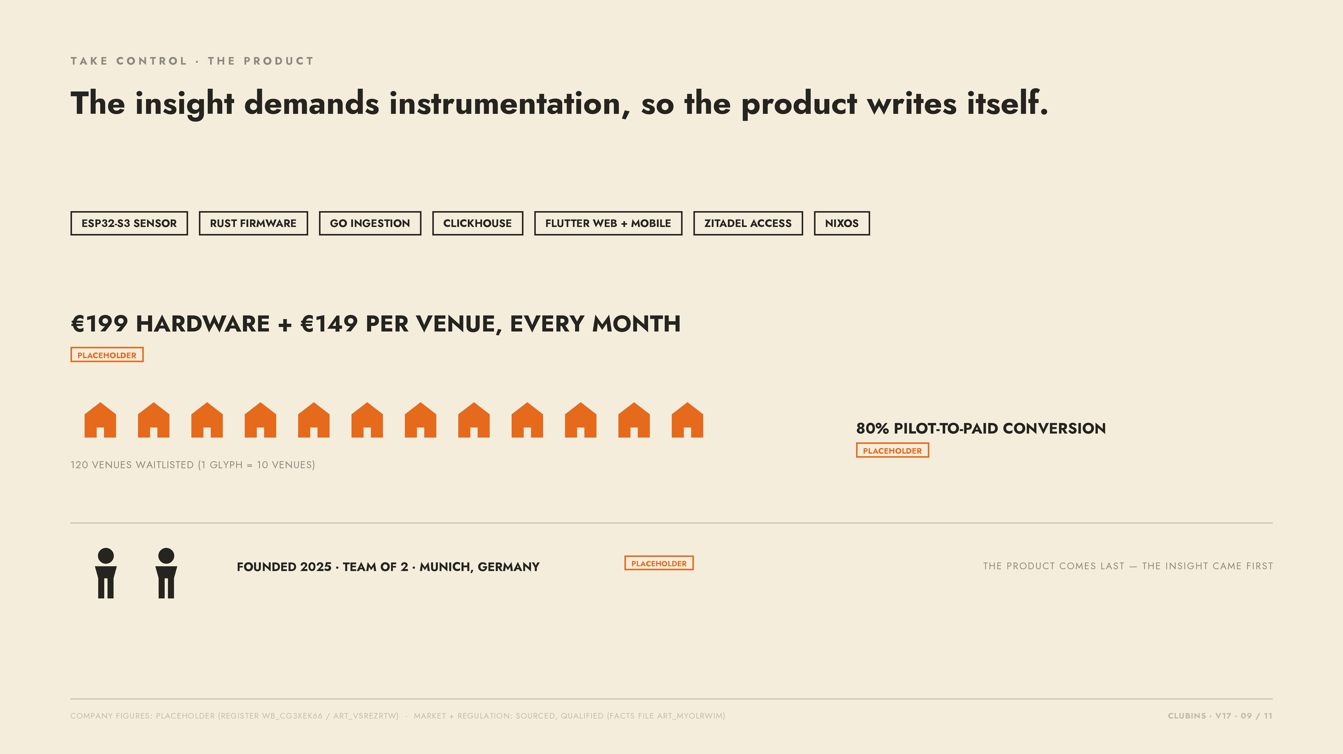
Notes:
Product appears late (Challenger order). 199/149/80%/120/2025/team-of-2 = PLACEHOLDER register values.

Slide 10
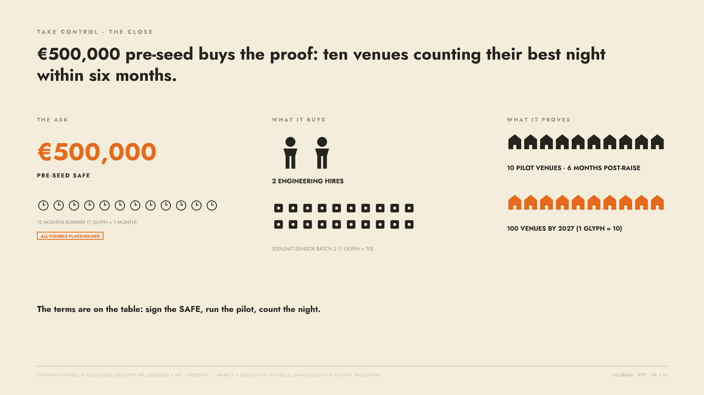
Notes:
Take control of the close: 500k SAFE, 12-month runway, 2 hires, 200-unit batch, 10 pilots, 100 venues by 2027 — all PLACEHOLDER register values.

Slide 11
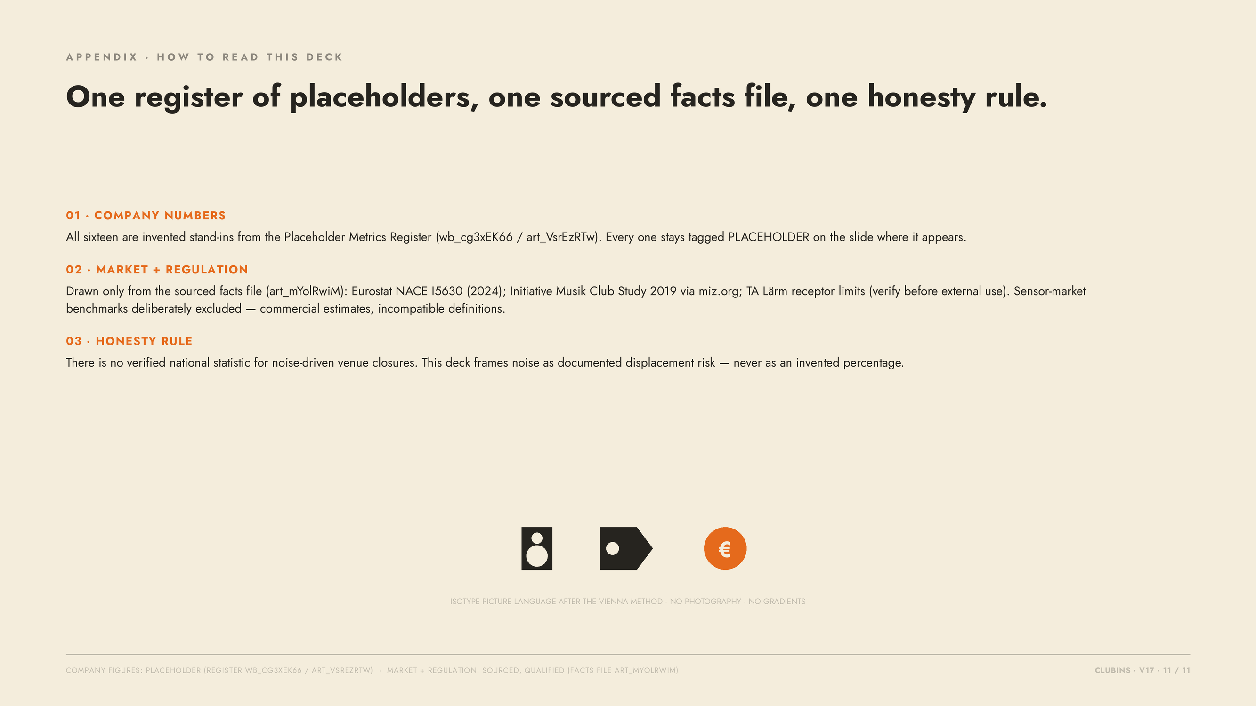
Notes:
STORY DOCTRINE — SOURCE DOCUMENT: Dixon, Tom & Adamson, Kevin, 'The Challenger Sale: Taking Control of the Customer Conversation' (Portfolio/Penguin, 2011); see also Dixon & Adamson, 'The End of Solution Sales', Harvard Business Review, July-August 2012. This deck implements the Challenger teach–tailor–take-control arc: slides 1–4 teach one commercial insight (the best night is real, measurable, unpriced), slides 5–8 tailor it to the operator, the market and the regulator, slide 9 shows the product last, slide 10 takes control of the close with a concrete pre-seed ask. VISUAL LANGUAGE: Isotype picture language after Otto Neurath's Vienna Method — flat pictogram unit-charts, charcoal ink on paper cream, one warm orange accent, no photography, no gradients. DISCIPLINE: all company figures are placeholders from register wb_cg3xEK66 / art_VsrEzRTw; market and regulation claims come only from the sourced facts file art_mYolRwiM; no verified national noise-closure statistic exists, so noise is framed as documented displacement risk.

